Slide 1
Website Board

Slide 2
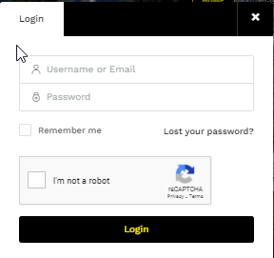
Step 1: Logging In
Before you can access your board you need to login.
To do that you will go onto the website and you will see the first page.
Once you are on the website there are fields on the top of the page.
To log in you will click the little person on the right.
Once you have clicked the person a box will come up where you will need to fill in details.
Your username and password will be given to you from support@goldenhomes.co.za
If you click this your details will stay filled in and you won’t have to login every time you want to access your board.
To be able to login you will need to click “I’m not a robot” and wait for it to load.
Once you have done that you can then click “login”

Slide 3
Step 1: Logging In
Once you have logged In you will be redirected to you board.
On the left hand side you will find different areas where you can access different features.
Step 2
Step 3
Step 4
Step 5
Step 6
Step 7
Step 8
Step 9
Step 10
Step 11

Slide 4
Board

Slide 5
Step 2: Board
Activities
Once you have logged In you will be redirected to you board.
When you are redirected your screen will look like this.
Here it will show you your activities
If you have leads it will show up on a time line (newest to oldest) and it will show you the property and the contact details of the client.
Leads will also show up as a percentage indicating your lead analytics up to 30 days.
These will only show up if you have listings and have had at least 1 enquiry.

Slide 6
Step 2: Board
Leads
The board has two sub features when you first go on it you will be on activities but you can also see your leads.
When you click into Leads your screen will look like this or if you have leads they will come up here.
You can also create your own lead.
E.g. if you get an enquiry off Property 24 you can add it here to keep track of all your leads across different resources on one system.
You can add a new lead by clicking either button

Slide 7
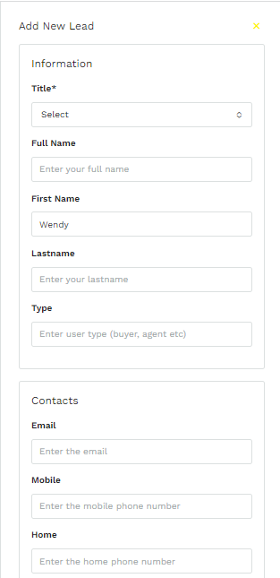
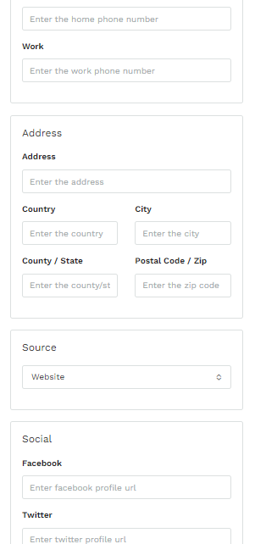
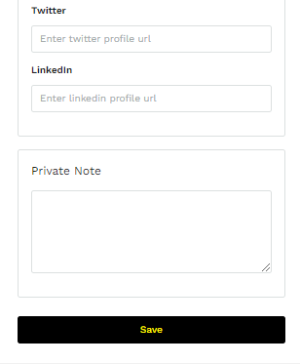
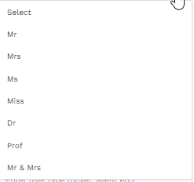
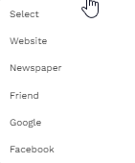
Step 2: Board
Leads
When you click either of the “Add new lead” button a contact form will show up on the right hand side of the screen.
The title of your lead is the only compulsory field here you will get a drop down box that will give you title options to chose from.
The X on the top right will delete the form.
Source is where the lead came from. here you will get a drop down box that will give you source options to chose from.
Once you have finished filling out all the information that you have/feel necessary you will click save and the lead will be created

Slide 8
Insights

Slide 9
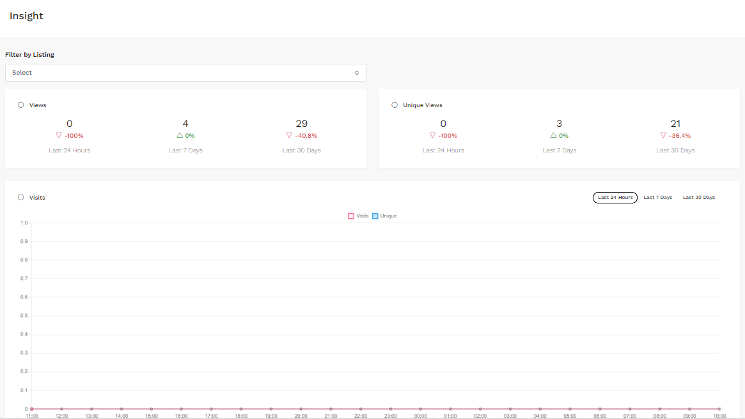
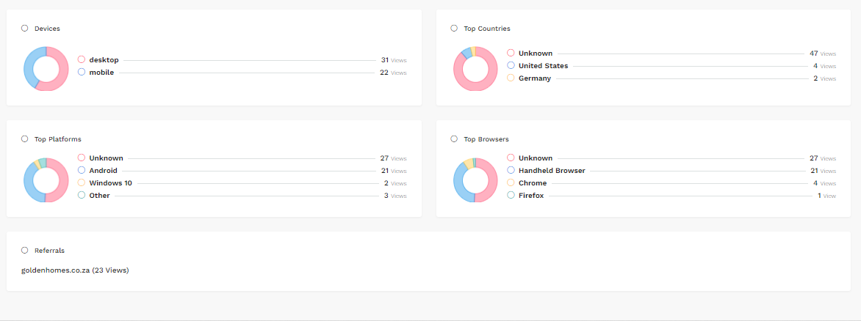
Step 3: Insights
Insights show your listing analytics like views, link clicks, etc.
When you click “insights” your screen will look like this and will show the analytics for all of your listings.
You can select individual listings to get further insight.

Slide 10
Step 3: Insights
To change listing you will go to “Filter by Listing” and press the button.
A drop down button will pop up and all your listings will come up.
You will type here
You can either search for a listing or you can find it in the options that come up.
Once you have chosen your listing your insight information will change

Slide 11
Step 3: Insights Views
Once you have chosen the listing you want you will be able to see all your insights.
For each listing you will be able to see how many views you have had in the last 24 hours, 7 Days and last month. These views show how many times someone has viewed the listing on our website.
Unique views are shown just as Views are, however unique views show how many new people have viewed your listing for the first time whereas views don’t take into account who has viewed before.

Slide 12
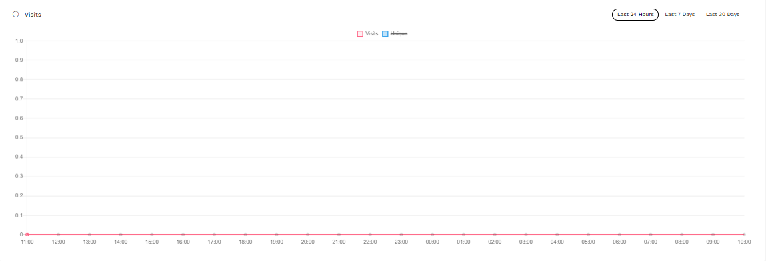
Step 3: Insights Visits
You can chose to have the graph reflect information from 24 hours, the last 7 days or the last month.
The line graph shows you the amount of and time of visits (normal and unique) on your website profile.

Slide 13
Step 3: Insights devices, countries, platforms, browsers and referrals.
Insights will also show you where your views come from and show it in a pie chart format
You will also be able to see your referrals where it will show what links were clicked when someone found your listing.

Slide 14
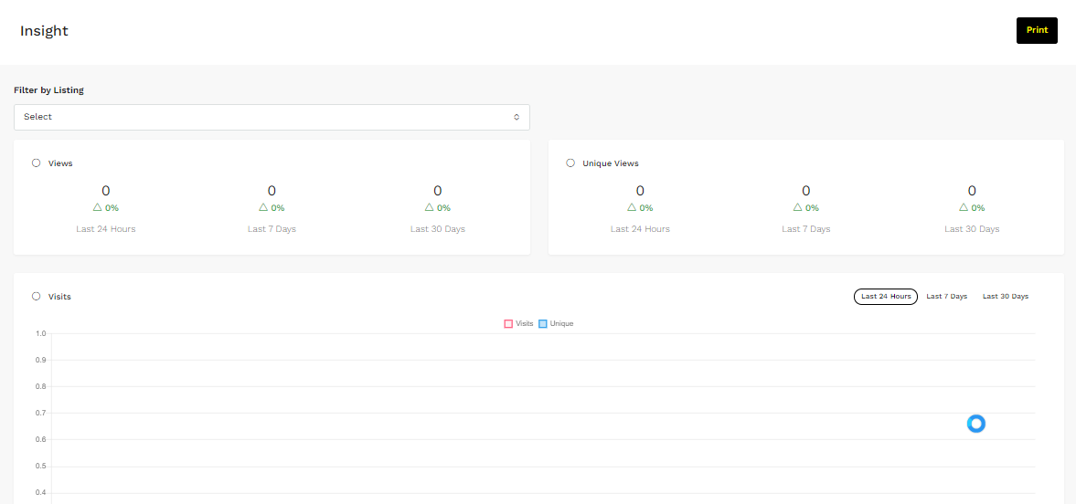
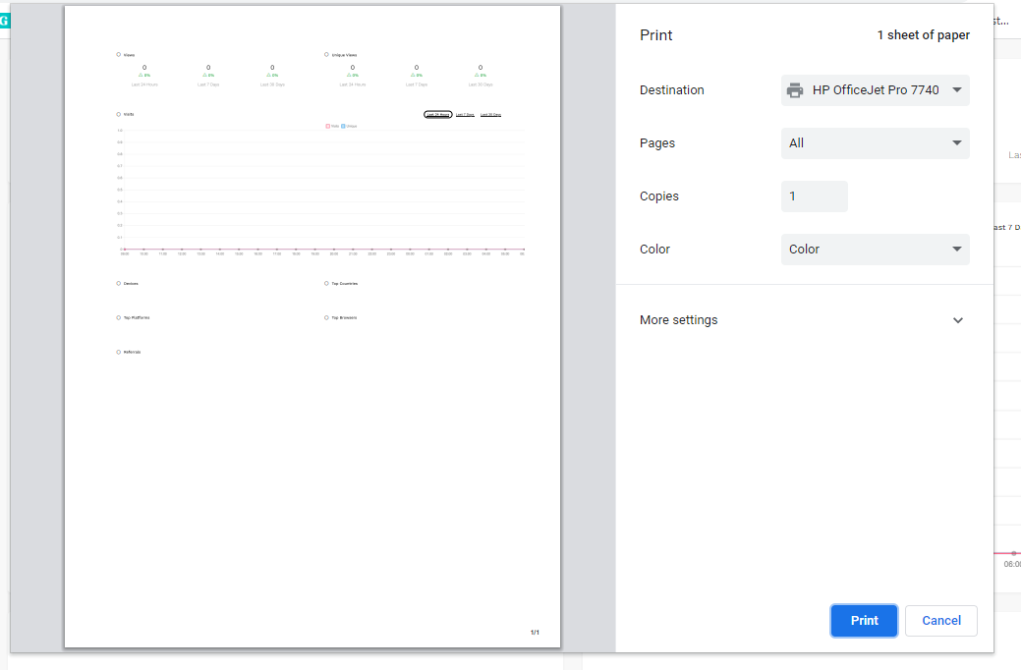
Step 3: Insights
You are also able to print your insights page.
To do this you will click the “print” on the top right corner.
Once you click “print” a print preview will come up and you will be able to print as normal.

Slide 15
Properties

Slide 16
Step 4. Properties
Here you can search for a property you have listed. You will use the address of the property here.
You can also create a listing from this section as well.
This is the featured image of your listing
Your properties/listings will come up like this.
The type of property will be here
The sale/rental price will be here
If you have featured your property it will be show here
You will find the street address by the title
See next page.
The status of your listing will show here, it will either say “approved”, “draft”, “pending” or “expired
The status will either be “for sale”, “for rent”, “sold”, “rented”, “expired” or “withdrawn”

Slide 17
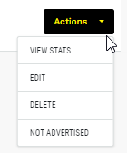
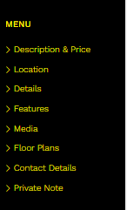
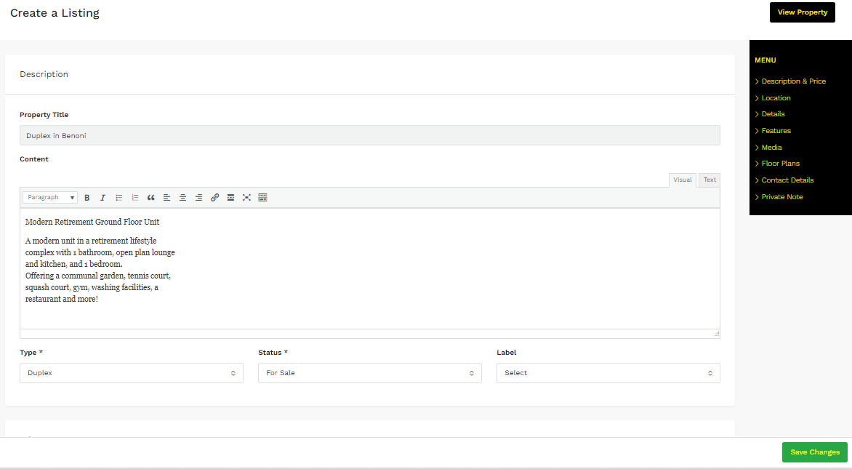
Step 4: Properties
When you click actions a drop down box with different actions will show up.
If you click “view stats” it will take you to your insights for that specific property.
If you click “edit” you will be redirected to edit your listing
If you click “delete” your listing will be deleted from the system
If you click “not advertised”
The box on the right will show you the different subsections of your listing so you can easily find the place where you want to edit your listing.
Once you have edited your listing you must click “save changes

Slide 18
Create a listing

Slide 19
How To Create A Listing
Agent Board

Slide 20
Step 1: Property Description
a
b
c
d
e
f

Slide 21
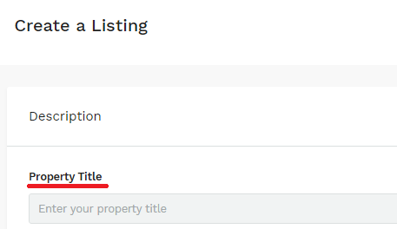
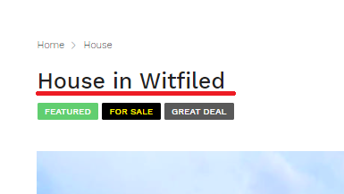
a. Property Title
Your property title is automatically generated and is greyed out.
Meaning you will not be able to fill in this.
Once you have finished your whole listing it will be generated.
It will look like this:

Slide 22
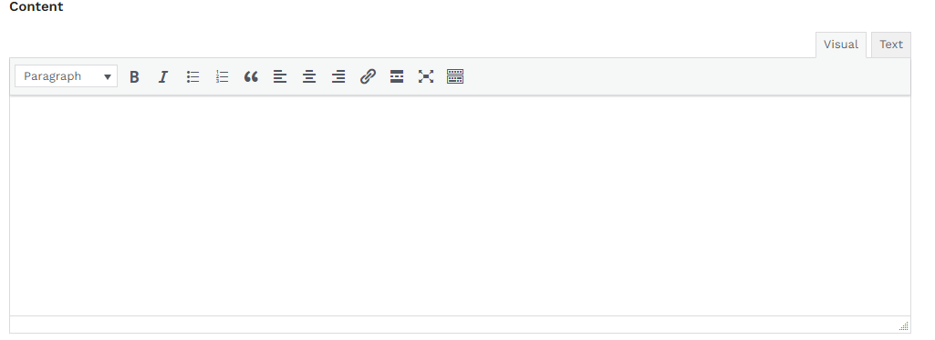
b. Description/Content
The content is the property’s description that will show on the website. Here it is important to write a good description.
You will be able to type in this box.
In your description you should have
A heading
A body that can be divided up into paragraphs if needed.
When you are busy with typing you will need to highlight/select your typing to change the style, make bold or put in italics. See next pages to see how to do it.

Slide 23
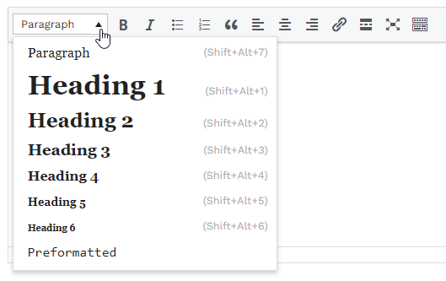
i)Heading
Your heading is a short powerful catchy phrase inviting the purchaser to read more.
This heading is NOT a heading like HOUSE IN KENSINGTON. The HOUSE IN KENSINGTON is populated automatically as the property title above so please do not repeat this in the heading.
It is advised that when you write your heading you change the formatting to “heading 1” or “heading 2” as it will stand out as a heading when you view the listing on the website.
To change the heading format click where there is a box and the word “Paragraph”
Once you have clicked the box options will appear and here is where you will chose your heading format.
Once you select your heading format and type it will go bold and bigger.

Slide 24
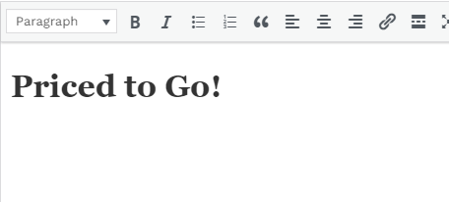
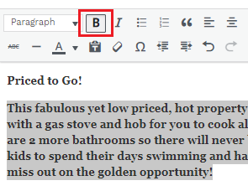
ii) Body
After you have created your heading you can just press your “enter” button and the formatting will go back to “paragraph”.
When typing your body you are going to describe the property using descriptive words that take the purchaser on a journey through the property. In this section you should be “talking” to the purchaser and giving little nuggets of information attracting him to the property.
Please avoid saying something along the lines of:
“2 bedroom house with modern kitchen”.
While you have the option to use Bold and Italics in your description we suggest you only do so when emphasising something. Otherwise keep to simple text.

Slide 25
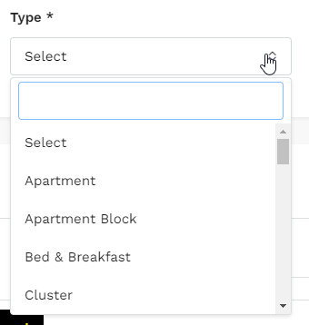
c. Property Type
Adding a property type is a compulsory field. This enables the system to classify what type of property your listing is and filter it to the relevant category on our website.
To select options you need to click on the double arrow to get a drop down box to appear.
Once you click it a drop down box will appear.
Here you will be able to type in the property type you are looking for or scroll to find it.
Type here
Scroll here

Slide 26
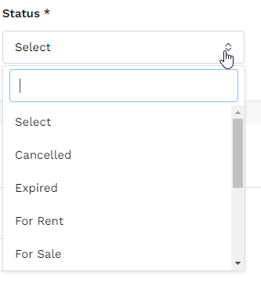
d. Property Status
Adding a property status is a compulsory field. This is used to classify what the status of the property is an filter it accordingly.
To select options you need to click on the double arrow to get a drop down box to appear.
Once you click it a drop down box will appear.
Here you will be able to type in the status you are looking for or scroll to find it.
Please change the status when the property is sold, withdrawn, etc.
Type here
Scroll here

Slide 27
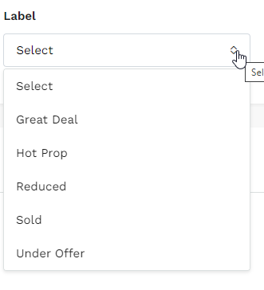
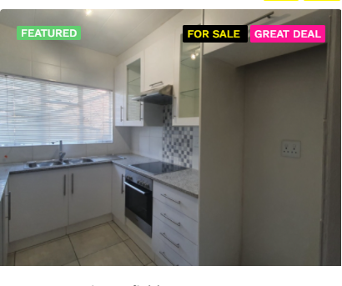
e. Property Label
Adding a property label is not a compulsory field. Therefore you can add a label if one is applicable to your listing
To select options you need to click on the double arrow to get a drop down box to appear.
The label will appear like this on your listing:
Once you click it you will only have these options as labels.

Slide 28
f. Price
Putting in a sale/rental price is a compulsory field.
When typing in your price please do not use ANY punctuation as the price will not recognise it as a number
Do:
2000000
Don’t:
2,000,000
2 000 000
2 000 000. 00

Slide 29
Save Draft
In-between step 1 and 2 you should save a draft.
To do this you will just click “save as draft” on the top right corner
Before Saving your final listings and sending it on to Management for approval, save it as a draft. Go to the properties section and click on the Property Image. This will open the listing and show you what it will look like once it is Published on the website. Check that you are happy with how you have created your advert. If you need to make changes you can do so and then submit.

Slide 30
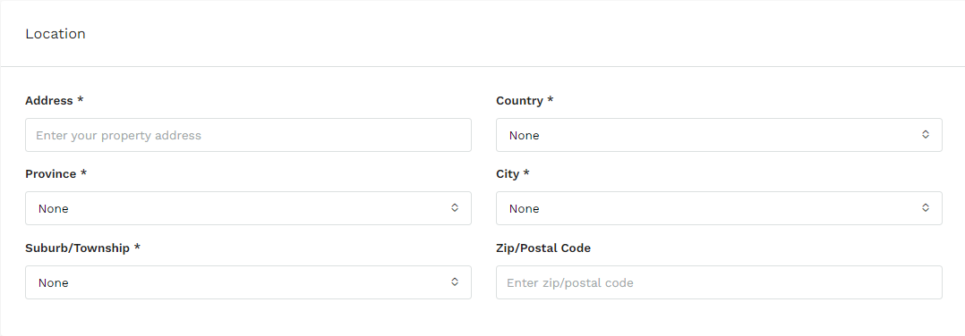
a. Location
When adding in the location you have to fill in all the fields that have a star next to it.
It is important to have the correct address filled in.
i
ii
iii
iv
v
vi

Slide 31
Step 2: Location
a
b

Slide 32
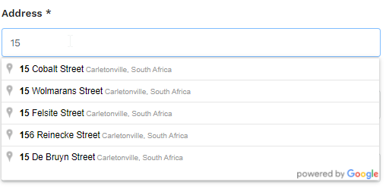
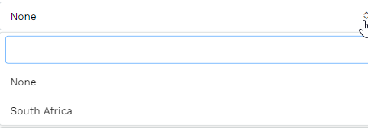
a. Location
Here you have to add the street address. When you start typing it will start giving you suggestions of locations you can use.
NB. YOU MUST TYPE YOUR ADRESS IN THE FOLLOWING ORDER
– Address. Country, Province, City, Suburb
If the address of your listing does not come up carry on typing in the address as follows:
Street number/name, suburb, city, country
i
If your address shows up in the suggest addresses click the applicable one, you will still need to fill out the rest of the fields.
ii
There is no other country listed, but if you do not select South Africa you will not be able to move onto the next step.

Slide 33
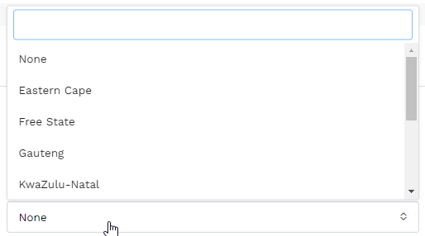
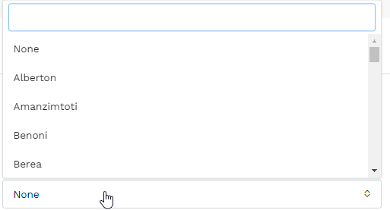
a. Location
iii
When selecting your province and city of your listing you will get a drop down box once you click the box. You can either search or scroll to find them.
type
scroll
iv

Slide 34
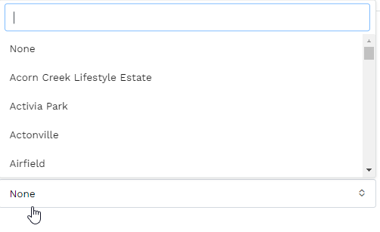
a. Location
When adding in your suburb, you can search for the suburb of your listing as all suburbs for the area in which you operate will come up.
Please make sure you chose the correct suburb for your listing.
If the suburb your listing is not available please email support@goldenhomes.co.za for it to be added in for you. In the meantime make it the closet suburb.
You do not need to add in the zip/postal code but if you do have it, add it anyway.

Slide 35
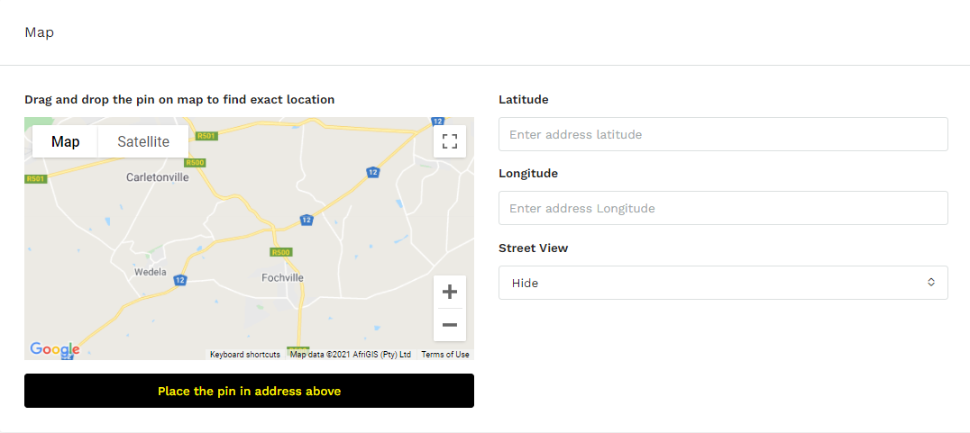
b. Map
If you selected an address option when you were adding in the address the map will automatically find the location, the same when you manually add in your address. This map does not show on the website if the street view option says “hide”

Slide 36
Step 3: Property Details
When adding your property details you must fill out every field that has a star next to it.
Please note there are no halves (e.g. 1.5) here you will have to decide to either round up or down.
Property Details are split into:
Details
Official Description
Additional Details.

Slide 37
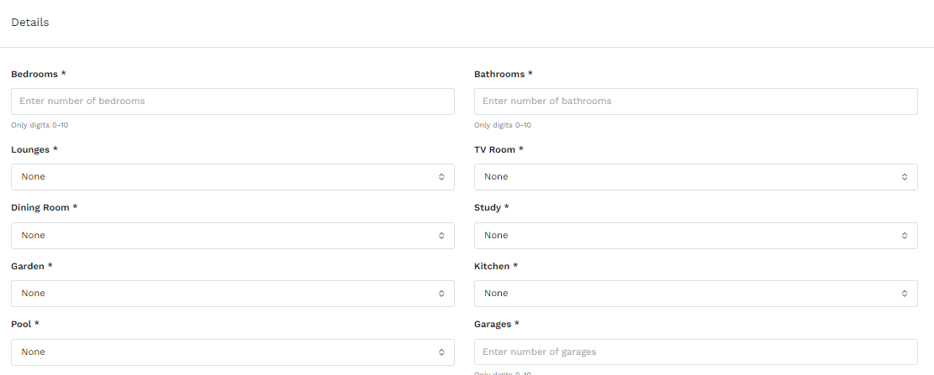
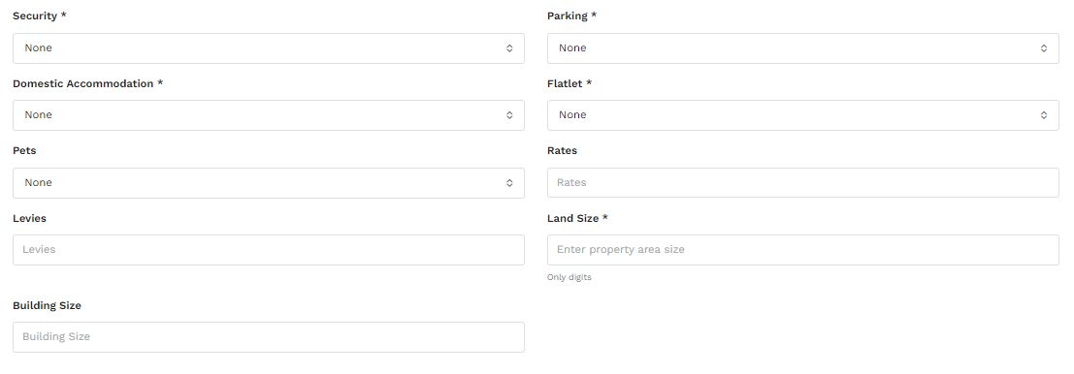
i. Details
Fill out all the fields but the most important ones are the ones with the stars. Throughout this step there will be compulsory fields that you need to fill out.
A drop down box will appear and you will get options to chose a number appropriate.
You must select your mandate agreement

Slide 38
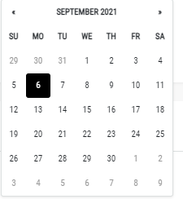
ii. Official Description
the erf number can be given to you by the seller or found on a rates account, Lightstone report/ property report
This is the suburb
When choosing your listed and expiry date it will come up as a calendar and you will have to chose both dates.
Please note after 90 days the system will automatically expire your listing, so you will then have to re-submit it once the 90 days are up and the property is still active.

Slide 39
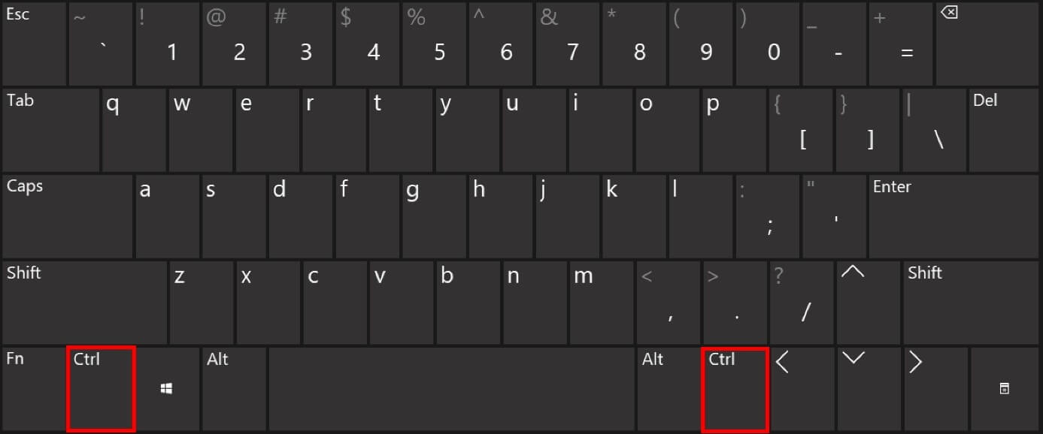
iii. Additional Details
Your additional features just add extra information regarding the property. This is not a compulsory field but adding additional features will better your listing.
The type will be your room you are describing
When selecting the feature in the room you will have to scroll to select them
To select more than 1 option you will have to press you ctrl button before you click on an option for it to select.
Do not scroll when you hold the ctrl button as it will cause you screen to zoom out.

Slide 40
Step 4: Features
Listing on Golden Homes means you are advertising on the Golden Homes website.
If you do not tick this your listing wont show up on the website.
If you chose to display google map you will show the street address on the listing and where to find the property
You can chose not to advertise your property.
This means it will not appear on the website but will sit in your properties on your agent board.
A property that is marked Not Advertised will show in your reports as an active property on the market but it will not show up on the website. This is for properties you either do not want to advertise for some reason or because there is another agent involved who does not allow you to advertise.
If you feature your property it means it will show up under “Exclusive Mandates” on the front page of the website.
You may only feature your property if you have a signed sole mandate and it has been approved by management.
Featured Properties are only activated by your Principal. If they do not approve then it will not show up as a featured property.

Slide 41
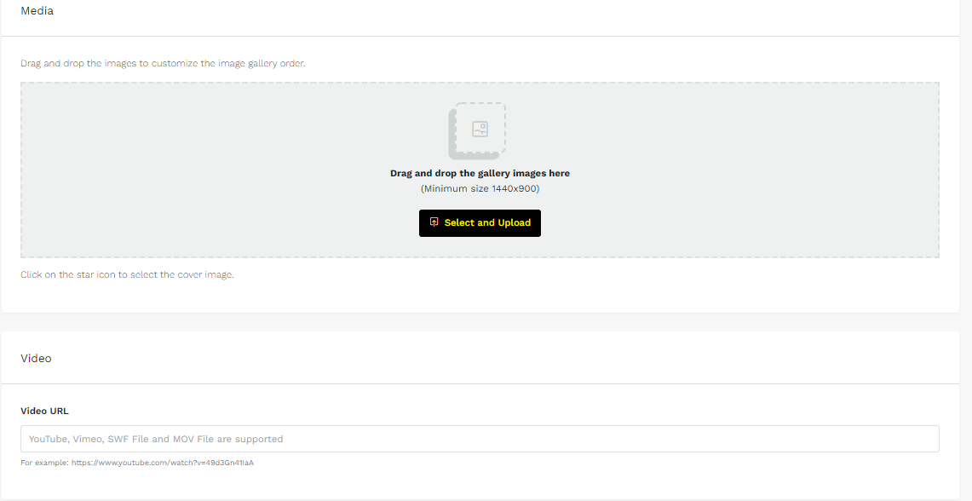
Step 5: Media
When uploading media it is recommended to save it as s draft before you add any images. This ensures that your listing saves and won’t be lost if you get kicked out of your listing.
When uploading media you can add up to 50 images and a video.
When up loading images you have prompts telling you how to upload.
Images can be in landscape and in portrait.
When uploading a video it needs to be a url link.

Slide 42
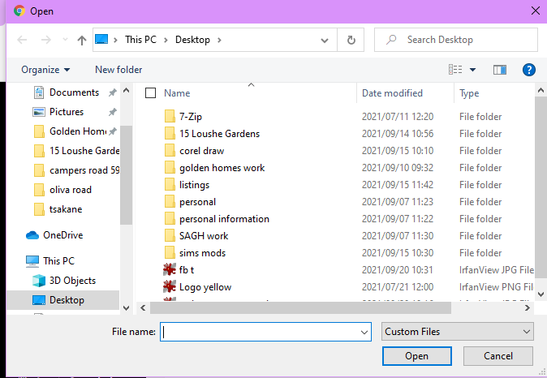
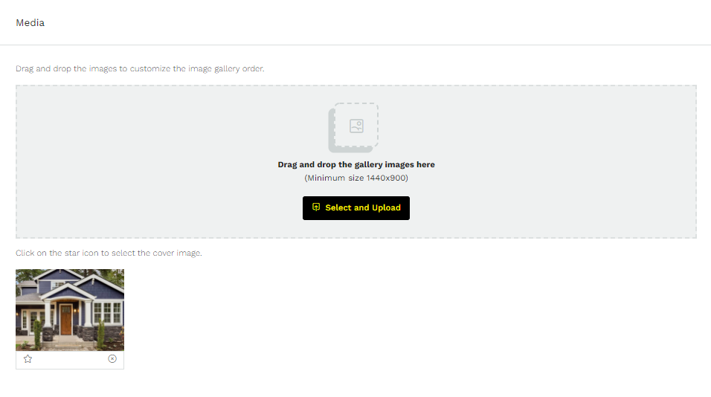
Step 5: Media
It is advisable to resize your images before loading as this can save you time. Images MUST NOT be less that 1440 x 900. If you do not know how to resize images then ask your Principal for training.
To upload images you will click on the “Select and Upload” button in the greyed out box.
When you click the button it will open up your computers file explorer, here you will be able to find your images.
Once you’ve found your images you will select them and they will start to upload.
The upload speed depends on your wifi and image quality
Once all your images are uploaded you will need to select a featured image. Your images will show up below the greyed out box.

Slide 43
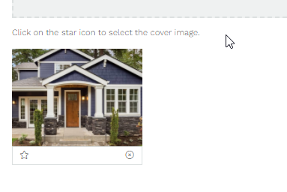
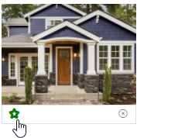
Step 5: Media
Below every image uploaded there is a star and cross.
The star enables you to feature an image. This means it will be the first image you see on the listing, only one image can be featured.
Once the star has been clicked it will go green.
The cross is the delete option.

Slide 44
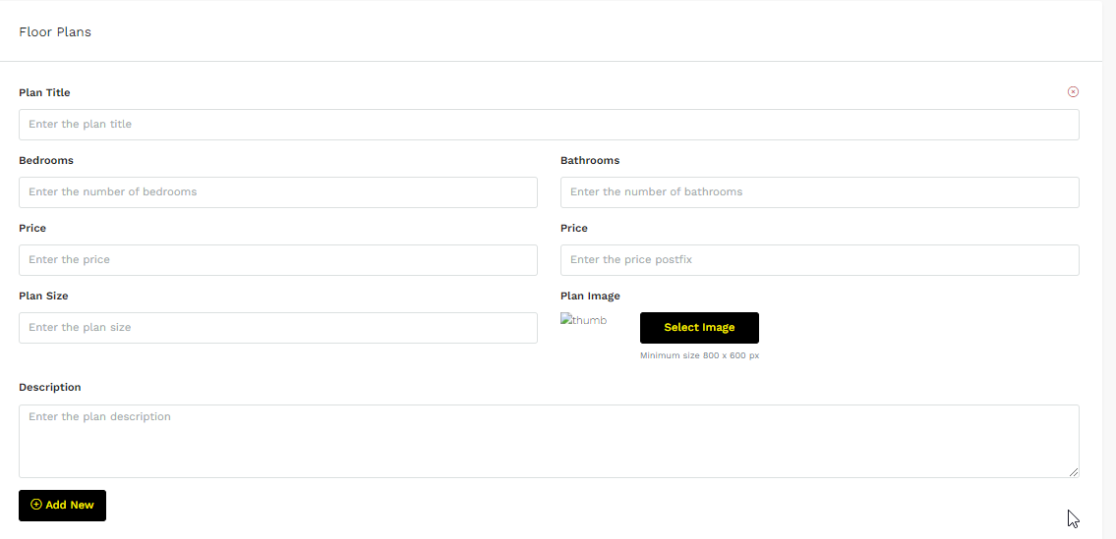
Step 6: Floor Plans
Floor plans are specifically for any property you are selling “Off Plan” meaning it is till going to be built.
However if you have the plans for a old property you can upload them here.

Slide 45
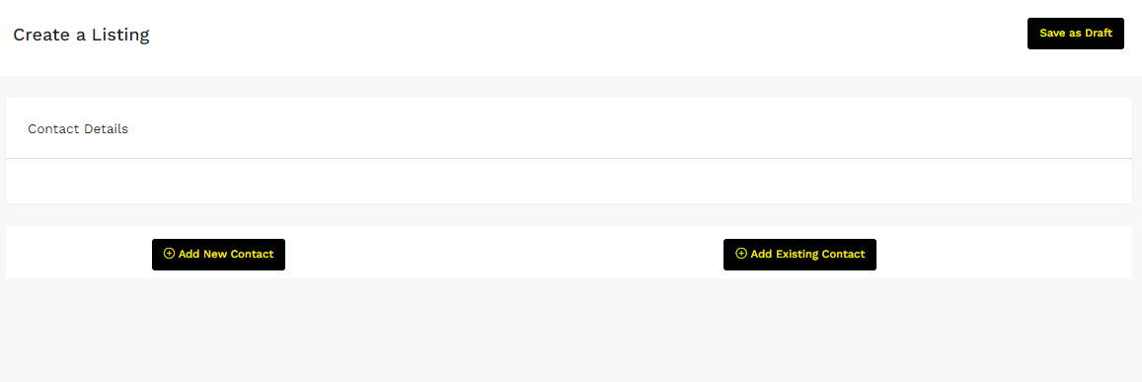
Step 7: Contact Details
When adding contacts, you are able to add a whole new contact or an existing contact.
The more details you have the better. The system is designed to send automated emails for birthdays, etc. This is specifically designed to assist you in maintaining contact with your clients which helps you build and effective referral base. It is important that you have the correct first name (or nickname) and email address. DO NOT add more that one name for first name.
a
b
To delete a contact you will press the X on the top right. After selecting each option

Slide 46
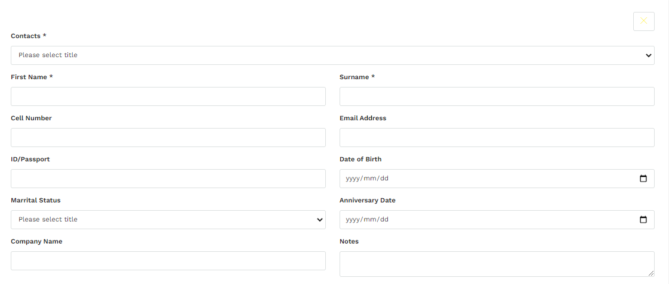
Step 7: Contact Details
To add a new contact you will click “add new contact”
Because you can add more than 1 contact, when choosing the contact title you get more than one option.
a
Once you click it this box will pull up.
Here you add in all the relevant information.
There are only 3 compulsory field that you have to fill in. But if you can it is advised you fill in more.
If your contact is working for someone else or belongs to a company you will add their company here.

Slide 47
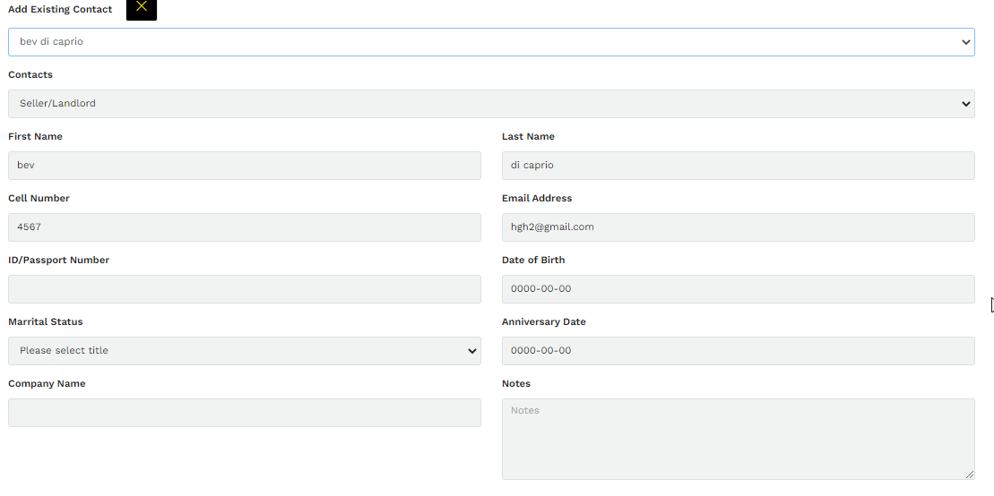
Step 7: Contact Details
b
When you select “Add existing contact” you will get a new block and the option to “select existing contact”
Once you click the box you will get a drop down box containing all your contacts, here you will the chose the contact you are looking for
Once you have selected the applicable contact it will automatically fill out all the needed contact information

Slide 48
Save Draft
In-between step 7 and 8 you should save a draft.
To do this you will just click “save as draft” on the top right corner
Before Saving your final listings and sending it on to Management for approval, save it as a draft. Go to the properties section and click on the Property Image. This will open the listing and show you what it will look like once it is Published on the website. Check that you are happy with how you have created your advert. If you need to make changes you can do so and then submit.

Slide 49
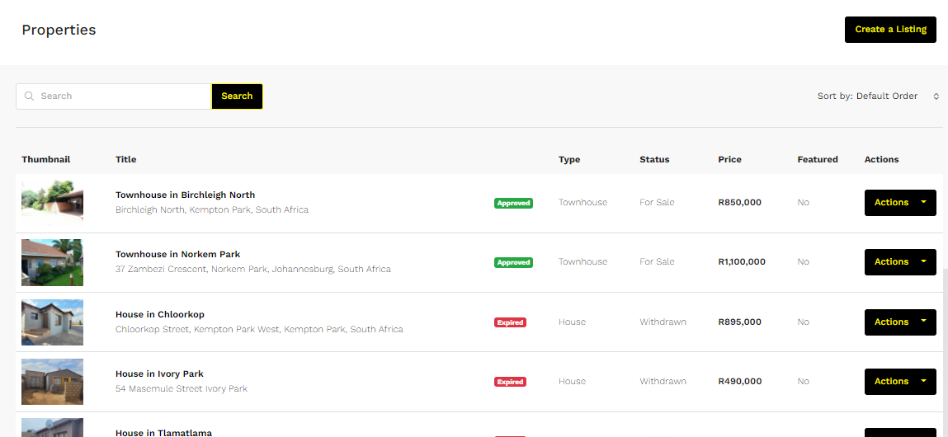
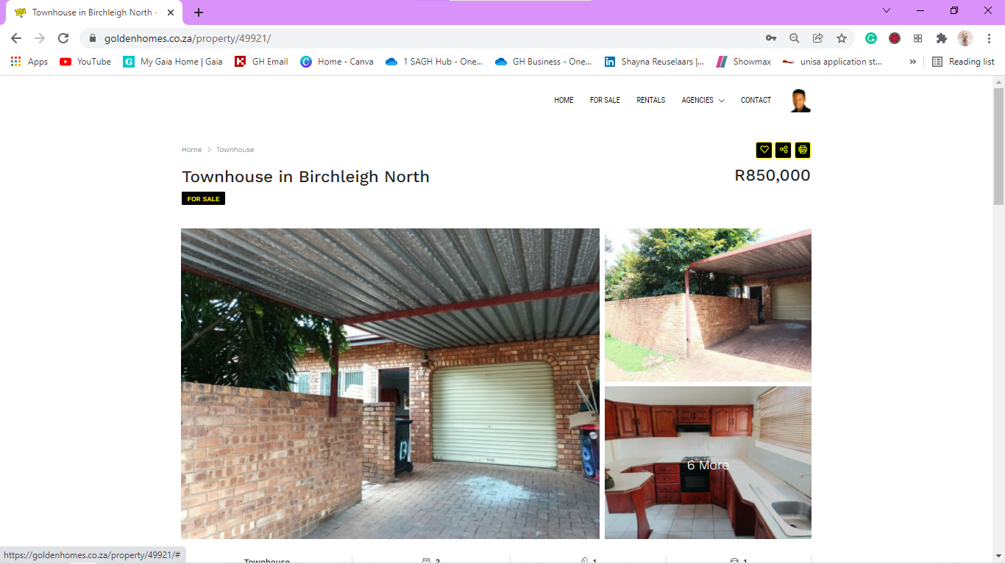
Viewing the listing before submitting
Before submitting and after making your listing a draft go to the properties section of your board see page 51 on how to find it.
When you are at your properties you will see all your listings.
To check what the listing looks like on the website, click on the thumbnail
When you click the thumbnail you will be redirected to what the listing will look like on the website. Here you can check if your listing is up to standard.

Slide 50
Step 8: Private Note & Submit
The last step is adding a private note and submitting your listing.
You do not have to add a private note but if there is any additional information in relation to your listing you are able to put it here and refer back to it when needed.
E.g. If there is a tenant in the property or the seller will be repainting as soon as the property has sold, or all the defects in the property.
After you have checked what your listing looks like on the website you can submit. Once you submit your property it will need to be approved by admin, once it has been approved it will be visible on the website.

Slide 51
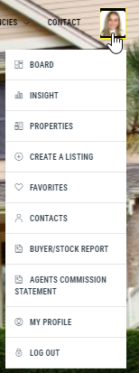
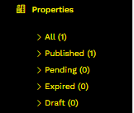
Where to find the listing.
After you have created the listing you will be able to view it from your “Properties” portion of your board.
Once you have clicked “properties” you will be redirected to this page.
OR
Here you will be able to see all your listings.
If you look to the left after you have clicked “properties” you will have subheadings that will separate all you published, pending, expired and drafted properties

Slide 52
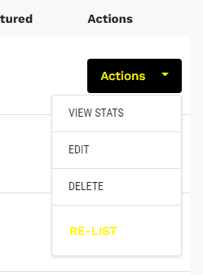
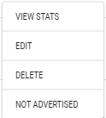
Viewing your Listing on the Board
Here is your actions box. Here you are given the following options. As you can see there are types of options that come up when you click the action button. These are dependent on the status of your property.
When you click on either option you will be redirected to a new page.
You have the delete option for your listing, however you cannot just delete the listing. You will need to change the status of the property to expired, and then tell management.

Slide 53
Step 5: Contacts
To add a new contact you will click here and you will be redirected to a new page
When you click into your contacts you will get a list of all your contact.
Depending on how many contacts you have, you can search them by name to find them quicker
If anything needs to be added or changed to a contact you will press edit and then be redirected to all your contact info.
When you have edited your contact, click submit to save

Slide 54
Step 5: Contacts
Because you can add more than 1 contact, when choosing the contact title you get more than one option.
These are compulsory fields that need to be completed
Once you have finished you will press submit for it to save.
If your contact is working for someone else or belongs to a company you will add their company here.

Slide 55
Step 6: Buyer/Stock Report.
The buyer stock report is a fantastic tool for you to use if you are looking for a specific property for a client as you can use this feature to search for stock and save it for each client you have and always have the information saved.
Customer name is your client(s)’s name.
The status of the property is what your client(s) are looking for.
E.g. to buy or to rent.
Type is the type of property that are looking for. Here you will click the box and select the relevant option (you can only chose 1)

Slide 56
Step 6: Buyer/Stock Report.
The min and max price will be determined by what your client is willing to spend.
Here you will just type in the prices. Please do not use any spaces or punctuation marks
Cell number without +27 and spaces
Name of client
VC
For the pool a drop down box will appear and here you will either chose yes or no.
For these fields you will type in the number of bedrooms/bathrooms/parking facilities/flatlets your client is looking for

Slide 57
Step 6: Buyer/Stock Report.
You can select more than one option for your city an suburb. Here you will need to press the Ctrl key on your keyboard for it to select options
When you select the city your client is looking for the suburbs will filter to those that are only in that city.

Slide 58
Step 6: Buyer/Stock Report.
Once you have filled in all the fields you can search all the Golden Homes listings to find listings that match what your client is looking for.
It is suggested that you save the search before you search as you will then have each client’s report saved and can refer back to them when or if you need them again.

Slide 59
Step 6: Buyer/Stock Report.
Once you have filled in all the fields and either saved your search or searched you will get a list off all the listings matching what you are looking for below the “search” and “save search” buttons.
Please see the examples below for what will happen when you search.
Example 1:
With this example you can see I have filled in all the fields and specified my area search but when I search for listings like it there are no listings that come up, it just says no record found. This is because there are no listings that match what the client would be looking for.
This is why it is important to save your search's, because you can then come back weekly to do another search to see if there are any new listings that match.

Slide 60
Step 6: Buyer/Stock Report.
Example 2:
With the second example you can see the search is much less specific. Here you can see all the listings in Benoni instead of just two specific suburbs like the first example. Because it is just a vague search there are many listings that come up
All the listing that match what you are searching for will come up here. You can then find all the information you will need to tell your client and phone the listing agent or seller for an appointment.
You are also able to delete listings from what comes up to make the list of available properties smaller and more specific to what the client would want to see.

Slide 61
Step 6: Buyer/Stock Report.
If you are coming back to search a previously made report that you have saved you will click the “view saved reports” button on the top right corner of the page to be redirected to your saved reports page.
Your saved reports page will look like this. You will then press the “go to search” and be able to search the report again.

Slide 62
Step 7: Agents Commission Statement
Your agent commission statement will show all your commission earned. You are able to set dates to see what you earned during a certain period.
You can either type in the dates or choose them from the calendar.
You can also export the statement to excel

Slide 63
Step 8: Favourites
Your favourites consist of any listing from the Golden Homes website that you have clicked the heart on. They will then come up as a list on your board. This would include other agents listings for you to be mindful of.
You can then view the listing or delete the listing by clicking the action button.

Slide 64
Step 9: Training Manual
The training manual consists of separate blog like posts that can assist you with any questions you might have relating to the real estate industry. To access them you just click the post you want to read.
Once you have clicked into the post you will be redirected to a new page. Here you will then click “read more” for the whole blog to show.
If you want to know more about the topic you can refer to the tags to the right and click them to find further information

Slide 65
Step 10: My Profile
Your profile will automatically be set up for you with your profile picture, username (you cannot change this), email address and full names.
If you chose to change what is already filled out please run it by your Principal first.
You need to update all these fields accordingly.

Slide 66
Other
If you have any other questions about how to use the website contact your Principal or supervisor

